Slide 1
Recurrent neural network

Slide 2
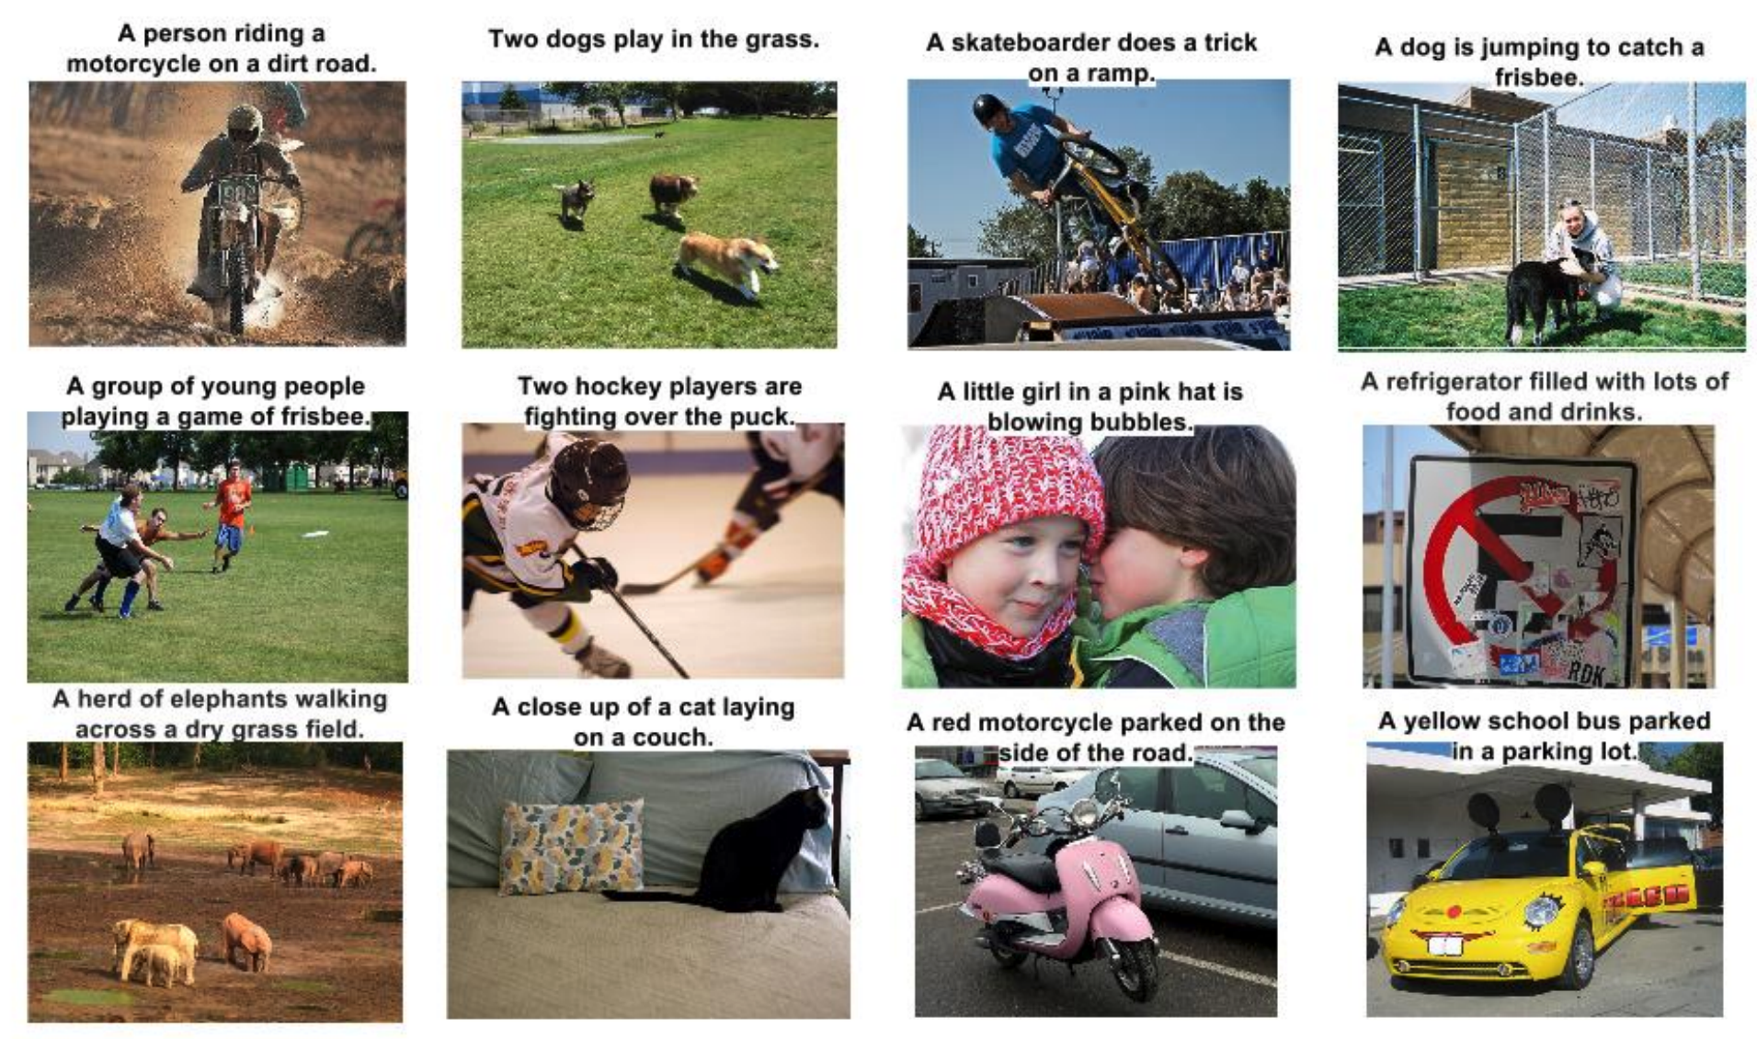
applications
Image captioning: https://arxiv.org/pdf/1411.4555.pdf

Slide 3
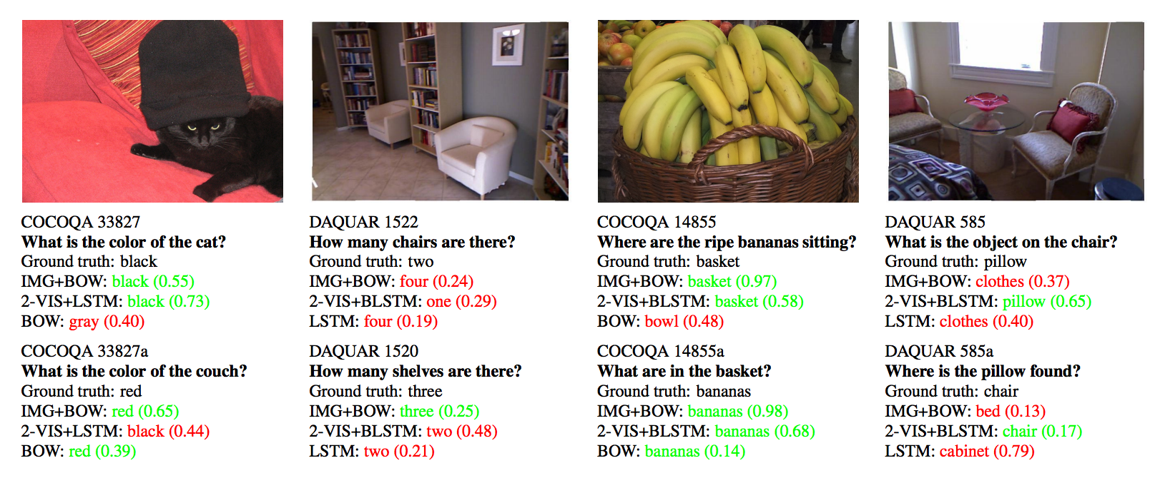
applications
Visual question answering: https://arxiv.org/pdf/1505.02074.pdf

Slide 4
applications
https://soundcloud.com/optometrist-prime/recurrence-music-written-by-a-recurrent-neural-network
https://soundcloud.com/o_ooooo/some-music-generated-by-char-rnn
https://github.com/mineshmathew/char_rnn_karpathy_keras

Slide 5
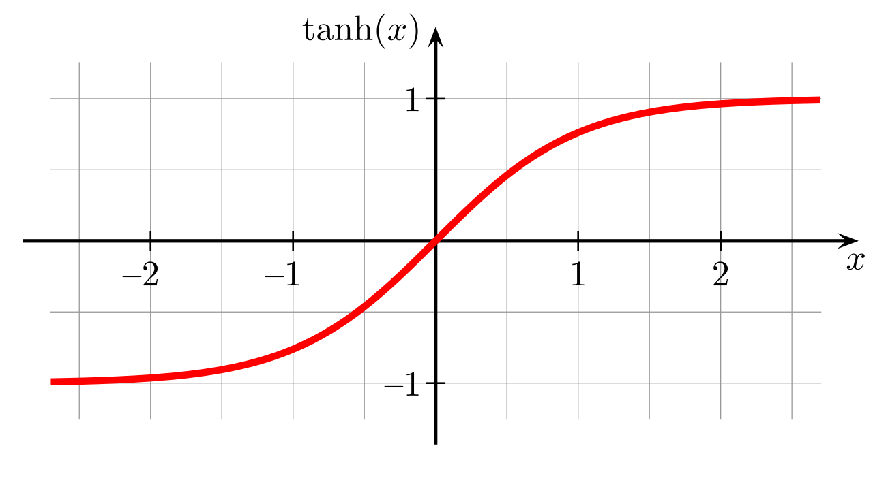
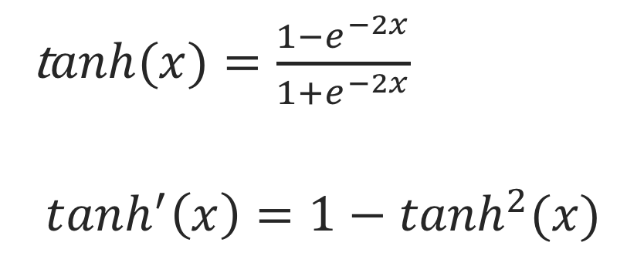
tanh
t$anh(x)=\frac{1−e^{−2x}}{1+e^{−2x}}$
$$tanh^{′}\left(x\right)=1−\tanh^{2}⁡(x)$$
https://commons.wikimedia.org/wiki/File:Hyperbolic_Tangent.svg

Slide 6
One-hot encoding
i [1, 0, 0, 0]
have [0, 1, 0, 0]
a [0, 0, 1, 0]
dream [0, 0, 0, 1]

Slide 7
Neural network – one to one
have [0, 1, 0, 0]
a [0, 0, 1, 0]
dream [0, 0, 0, 1]
y
y
y
x
x
x
I [1, 0, 0, 0]
have [0, 1, 0, 0]
a [0, 0, 1, 0]
Similar to Markov Chain

Slide 8
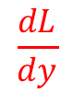
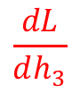
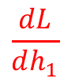
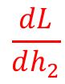
RNN – many to one
dream [0, 0, 0, 1]
Forward prop
Back prop
$$\frac{dL}{dy}$$
1
y
h₃
$$\frac{dL}{dh_{3}}$$
2
h₁
h₂
h₀
$$\frac{dL}{dh_{1}}$$
4
$$\frac{dL}{dh_{2}}$$
3
x₁
x₂
x₃
I [1, 0, 0, 0]
have [0, 1, 0, 0]
a [0, 0, 1, 0]

Slide 9
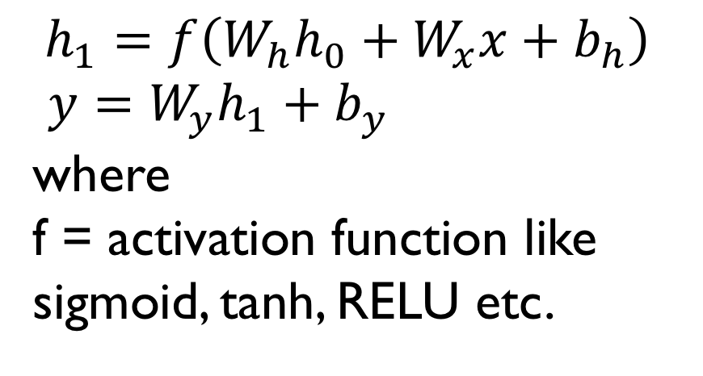
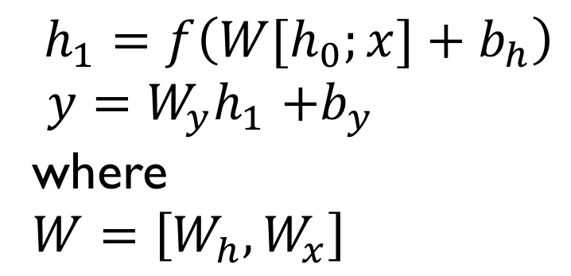
RNN schematic
$$h_{1}=f\left(W_{h}h_{0}+W_{x}x+b_{h}\right)$$
$y=W_{y}h_{1}+b_{y}$
where
f = activation function like sigmoid, tanh, RELU etc.
y
W_{y}
h₀
W_{h}
h₁
W_{x}
$$h_{1}=f\left(W[h_{0};x]+b_{h}\right)$$
$y=W_{y}h_{1}$ $+b_{y}$
where
$$W=\left[W_{h}, W_{x}\right]$$
x

Slide 10
Rnn schematic - Multilayer perceptron
y
y
W_{y}
W_{y}
h₁
h₁
W
W_{x}
h₀
W
x
h₀
x

Slide 11
Multilayer perceptron
y_{t}
W_{y}
h_{t}
W
h_{t-1}
x_{t}

Slide 12
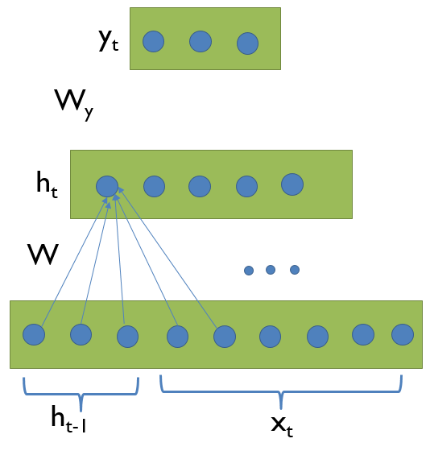
Rnn schematic
y_{t+2}
h_{t+1}
h_{t+2}
h_{t}
x_{t+1}
h_{t+1}
x_{t+2}

Slide 13
RNN schematic – size of matrices
Wh - (nh, nh)
Wx - (nh, nv)
Wy - (nv, nh)
h - (nh,1)
x - (nv,1)
y - (nv,1)
bh - (nh, 1)
by - (nv, 1)
y
W_{y}
h₀
W_{h}
h₁
W_{x}
x

Slide 14
RNN schematic
Commonly used diagram but not informative.
y
x

Slide 15
RNN schematic
Fully connected network for classification
y_{n}
h_{n}
h₁
h₂
h₀
x₁
x₂
x_{n}

Slide 16
Important note
The weights are shared over time (i.e.,) weight that is updated in time step1is updated in time step 2 etc.
The RNN architecture can be viewed as a neural network if it is unrolled over time, a generally preferred method for understanding.

Slide 17
Problem with regular Rnn
Remember the derivative of sigmoid function is sigmoid(x)*(1-sigmoid(x))
The maximum value of 0.25. If we add multiple layers, the gradient will cause weight updates to become smaller. This is called vanishing gradient problem. It prevents effective training of deep networks.
Similar problem exist with tanh as well.

Slide 18
Problem with regular Rnn
If you use RELU, you may experience exploding gradient as individual gradient factor > 1.

Slide 19
Long short term memory
Overcomes the drawbacks of Basic RNN by forgetting the most recent things.
Uses sigmoid and tanh and hence prevents exploding gradient.
Has bypass mechanism to prevent vanishing gradient problem.

Slide 20
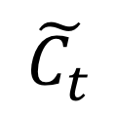
C_{t-1}
C_{t}
⊗
⊕
tanh
f_{t}
⊗
⊗
i_{t}
o_{t}
$$\tilde{C_{t}}$$
Vanilla
RNN
σ
σ
tanh
σ
W_{f}
Wi
W_{c}
Wo
h_{t}
h_{t-1}
x_{t}
http://colah.github.io/posts/2015-08-Understanding-LSTMs/

Slide 21
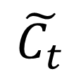
C_{t-1}
C_{t}
⊗
⊕
tanh
f_{t}
⊗
⊗
Forget gate
i_{t}
o_{t}
$$\tilde{C_{t}}$$
σ
σ
tanh
σ
W_{f}
Wi
W_{c}
Wo
h_{t}
h_{t-1}
x_{t}

Slide 22
C_{t-1}
C_{t}
⊗
⊕
Input gate
tanh
f_{t}
⊗
⊗
i_{t}
o_{t}
$$\tilde{C_{t}}$$
Update gate
σ
σ
tanh
σ
W_{f}
Wi
W_{c}
Wo
h_{t}
h_{t-1}
x_{t}

Slide 23
C_{t-1}
C_{t}
⊗
⊕
tanh
f_{t}
⊗
⊗
i_{t}
o_{t}
$$\tilde{C_{t}}$$
Output gate
σ
σ
tanh
σ
W_{f}
Wi
W_{c}
Wo
h_{t}
h_{t-1}
x_{t}

Slide 24
LSTM forward propagation
Created using http://latex2png.com
Notes:
\begin{equation} \begin{split} & f_t = \sigma(\mathbf W_f . [h_{t-1}, x_t]+ \mathbf b_f) \\& i_t = \sigma(\mathbf W_i . \mathbf [h_{t-1}, x_t]+ \mathbf b_i) \\ & \tilde{{C_t}} = tanh(\mathbf W_c . \mathbf [h_{t-1}, x_t]+ \mathbf b_c) \\& C_t = f_t . C_{t-1} + i_t . \tilde{{C_t}} \\& O_t = \sigma(\mathbf W_o . \mathbf [h_{t-1}, x_t]+ \mathbf b_o) \\& h_t = O_t . tanh(C_t) \\ \end{split}\end{equation}

Slide 25
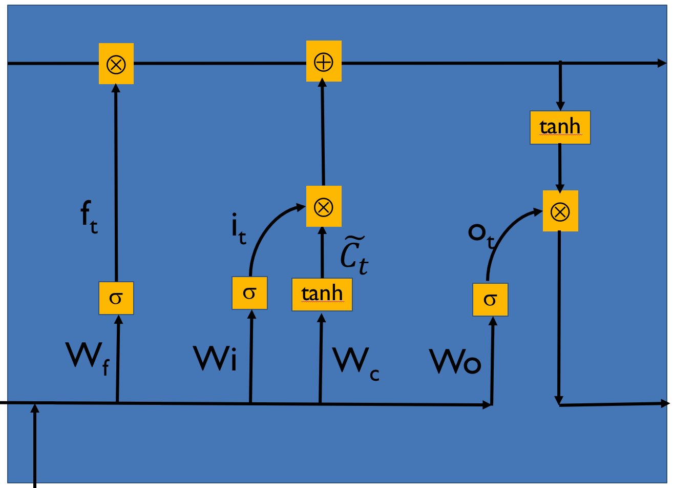
Chaining lstm cells
C_{t}
C_{t+3}
h_{t}
h_{t+3}
x_{t}
x_{t+1}
x_{t+2}

Slide 26
GATED Recurrent unit (GRU)
Created using http://latex2png.com
Notes:
\begin{equation} \begin{split} & f_t = \sigma(\mathbf W_f . [h_{t-1}, x_t]+ \mathbf b_f) \\& \tilde{{C_t}} = tanh(\mathbf W_c . \mathbf [h_{t-1}, x_t]+ \mathbf b_c) \\& C_t = f_t . C_{t-1} + (1-f_t) . \tilde{{C_t}} \\& O_t = \sigma(\mathbf W_o . \mathbf [h_{t-1}, x_t]+ \mathbf b_o) \\& h_t = O_t . tanh(C_t) \\ \end{split}\end{equation}

Slide 27
Word embedding
The problem with the approach we took for the RNN and LSTM code is the fact that the one-hot encoded input and output are mostly sparse. To overcome this, few embedding techniques have been created to produce dense embedding.
These techniques have properties such as reduced storage need for embedding, similar words are neighbors thus providing RNN a human like understanding of relationship between words
There are two popular methods for embedding. They are
Word2Vec https://www.tensorflow.org/tutorials/word2vec
Global Vectors for Word Representation (GloVe) https://nlp.stanford.edu/projects/glove/
You can download pre-trained word embedding using gensim module (https://radimrehurek.com/gensim/).

Slide 28
reference
http://karpathy.github.io/2015/05/21/rnn-effectiveness/
Ian Goodfellow et.al., “Deep learning”, Chapter 10
http://colah.github.io/posts/2015-08-Understanding-LSTMs/
https://www.cs.toronto.edu/~hinton/csc2535/notes/lec10new.pdf
https://medium.com/@godricglow/a-deeper-understanding-of-nnets-part-3-lstm-and-gru-e557468acb04
https://www.youtube.com/watch?v=WCUNPb-5EYI LSTM by Brandon Rohrer

